Slide 1

Malicious File Detection Model
Vinay cherupally : 220001021
Sai Pavan Bhavanam : 220001018

Slide 2
Introduction
Objective
Dataset
Classify PDF files as benign or malicious
dataset-1 (CIC-Evasive-PDFMal2022)
This project focuses on using static analysis techniques, which involve examining the contents and structure of PDF files without opening or running them. Unlike dynamic analysis, which requires a sandbox environment and incurs runtime overhead, static analysis offers the advantages of speed, safety, and scalability.
dataset-2

Slide 3
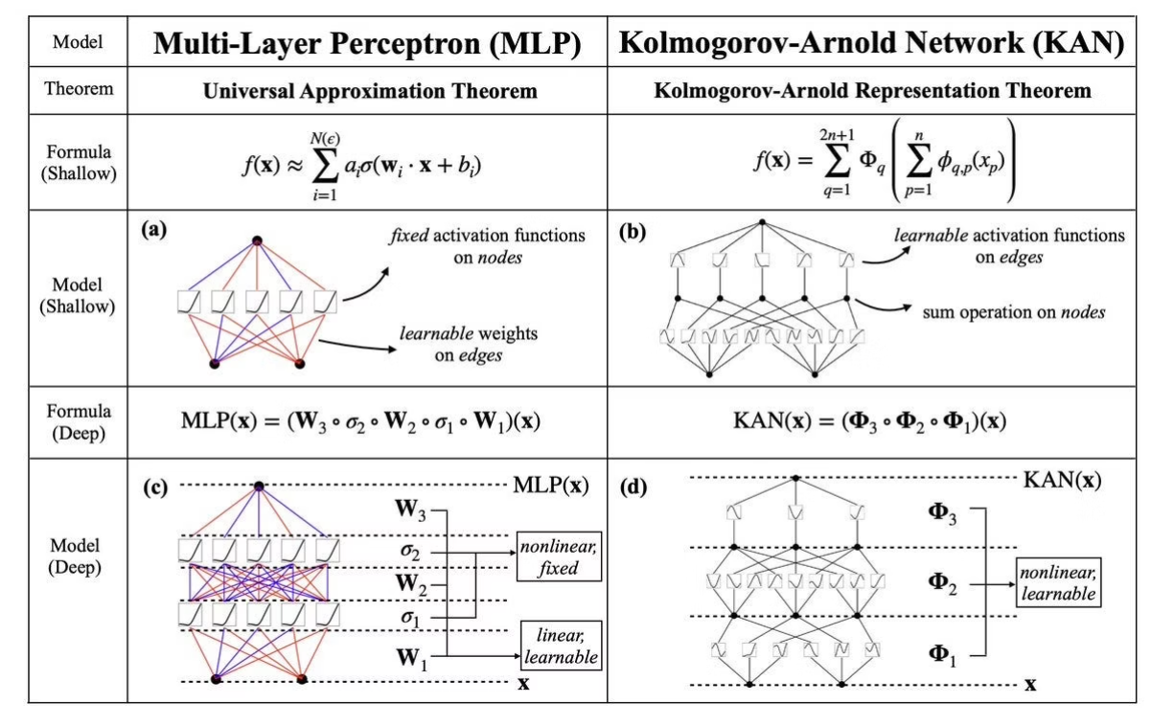
Model Overview
Kolmogorov-Arnold Networks (KANs)
Foundation: Based on Kolmogorov-Arnold representation theorem for multivariate functions.
Key idea: Any multivariate function decomposes into sums of univariate functions.
Innovation: KANs replace fixed activation functions with learnable activation functions on edges

Slide 4
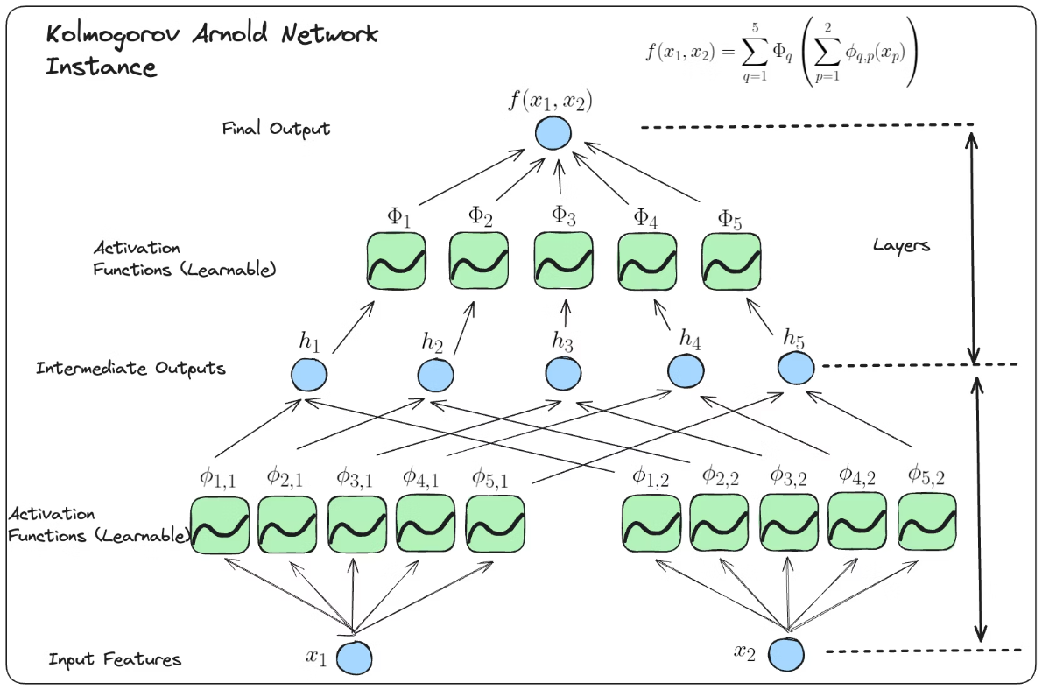
Architecture
The activation function in the KAN model is a combination of two parts
ϕ(x) = w_b*b(x) + w_s*spline(x)
b(x) = silu(x) = x / (1 + e^(-x))
spline(x) = ∑​c_i​*B_i​(x)
The activation function is learning only from the spline part (the other part is static)

Slide 5
KAN Model Pipeline
Data Splitting: 60% training, 20% validation, 20% test set for robust evaluation.
Model Architecture: Built on scikit-learn BaseEstimator with customizable hidden layers.
Activation Functions: Uses SiLU bias and B-Spline basis activations for flexibility.
Training Loop: AdamW optimizer with ExponentialLR scheduler for efficient learning.
Early Stopping: Stops training if validation loss worsens after two epochs.

Slide 6
Model Performance and Parameters
Dataset
Samples
Features
Accuracy
Cohen's Kappa
Sensitivity
Specificity
Matthews Corr. Coef.
F1 Score
Dataset 1
10,023
31
90.87%
81.55%
0.9127
0.9038
0.8156
0.9712
Dataset 2
2,001
12
97.75%
95.51%
0.9300
0.9652
0.8958
0.9925

Slide 7
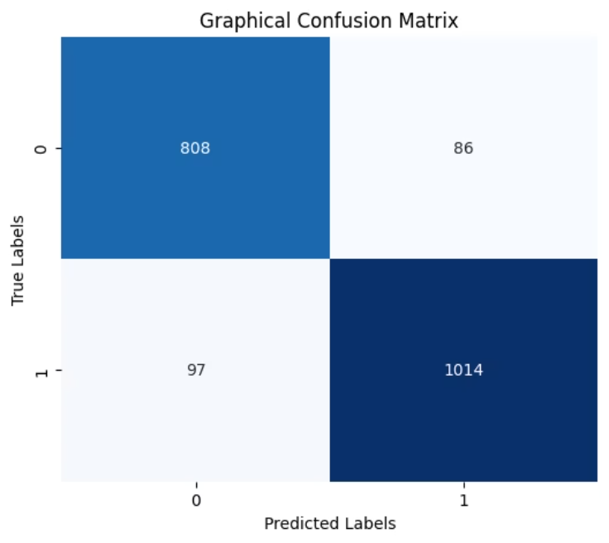
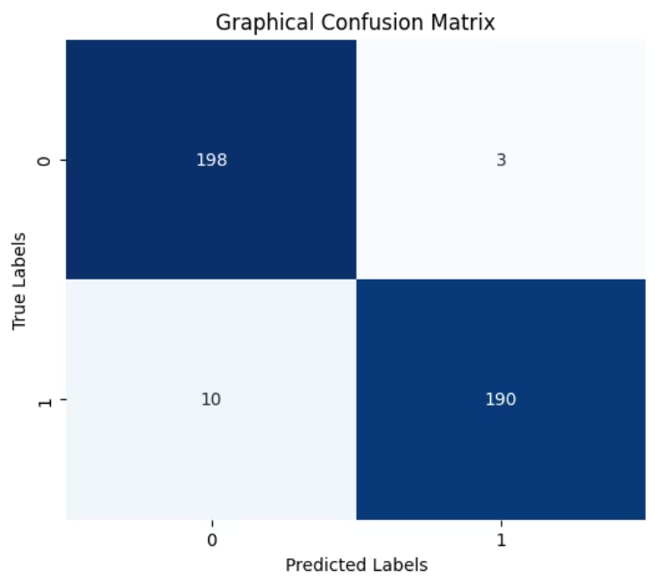
Confusion Matrix Analysis
DATASET - 1
DATASET - 2

Slide 8
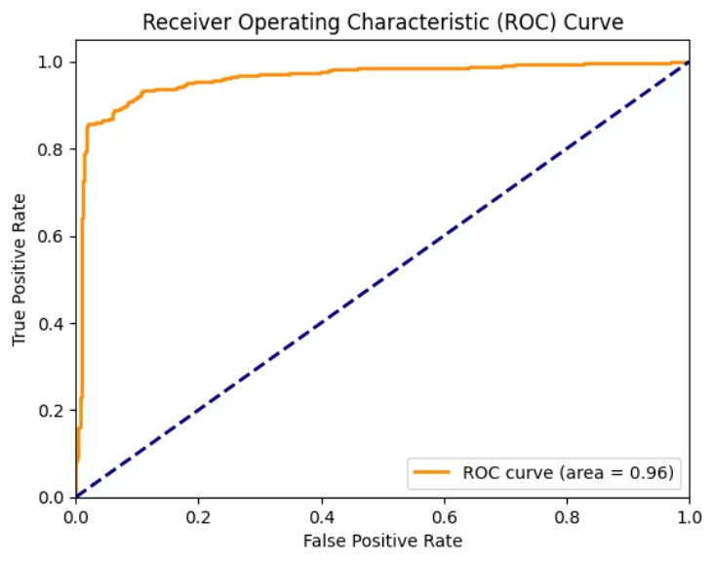
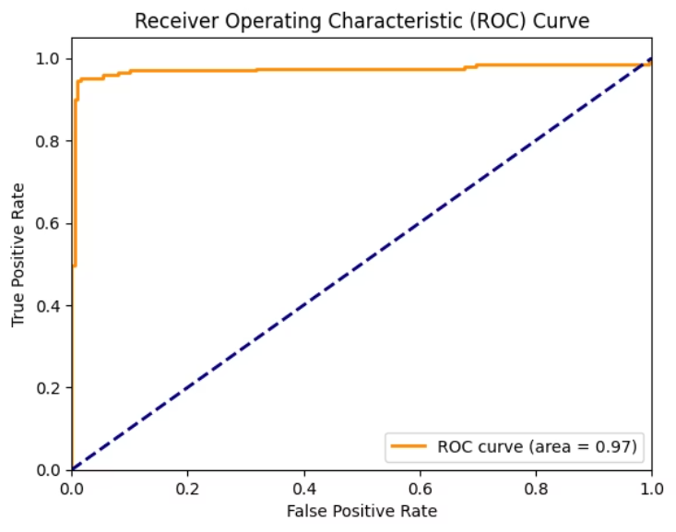
ROC Curve Analysis
Area Under Curve (AUC): 0.99 indicating excellent discriminatory power.
Sensitivity and Specificity: The curve shows high sensitivity and specificity distinguishing benign and malicious files.
Robust Classifier: Approaches the top-left corner, minimizing false positives and negatives.

Slide 9
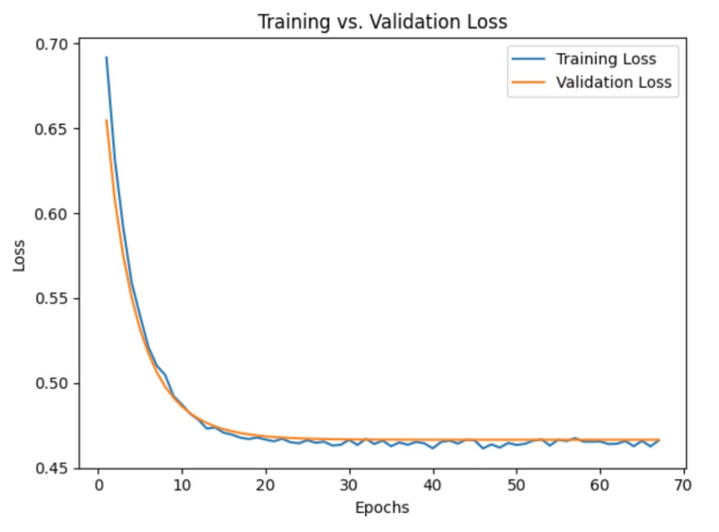
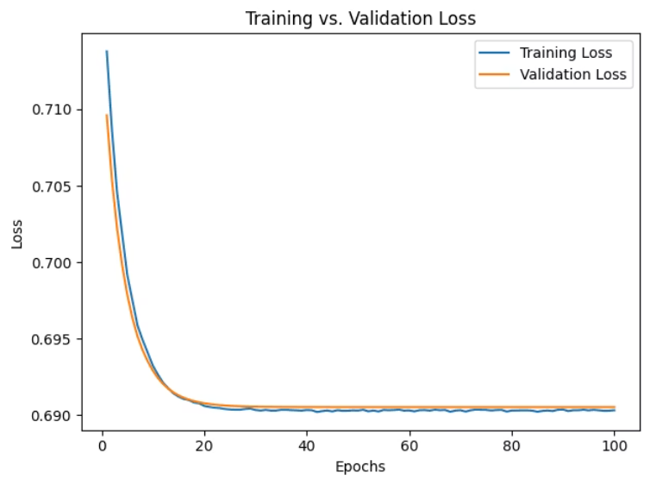
Train vs Validation Loss Curves
DATASET-1
DATASET-2
Low Loss Values: Both training and validation losses converge to low values, indicating a well-trained model.
Minimal Overfitting: The gap between training and validation loss remains small, suggesting good generalization.
Stable Learning: Loss curves flatten over time, showing that the model has reached stable performance.

Slide 10
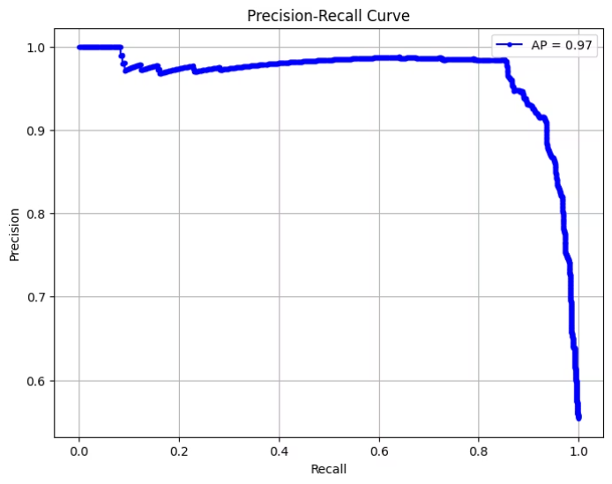
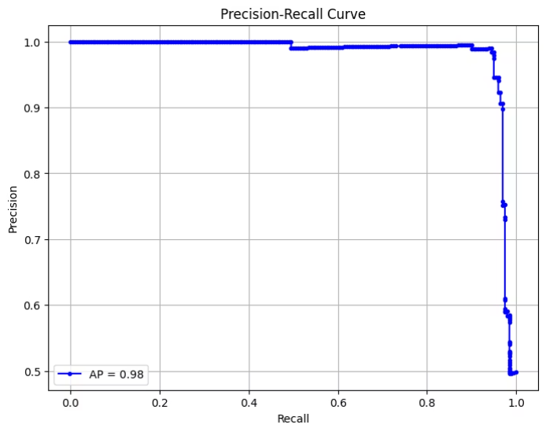
PRECISION-RECALL CURVES
Average Precision (AP) = 0.97~0.98: Indicates perfect balance between precision and recall.
High Precision and Recall: The curve remains near the top-right corner, reflecting minimal false positives and false negatives.
Robust Detection Capability: Excellent for imbalanced classification, showing the model effectively distinguishes between relevant and irrelevant instances

Slide 11
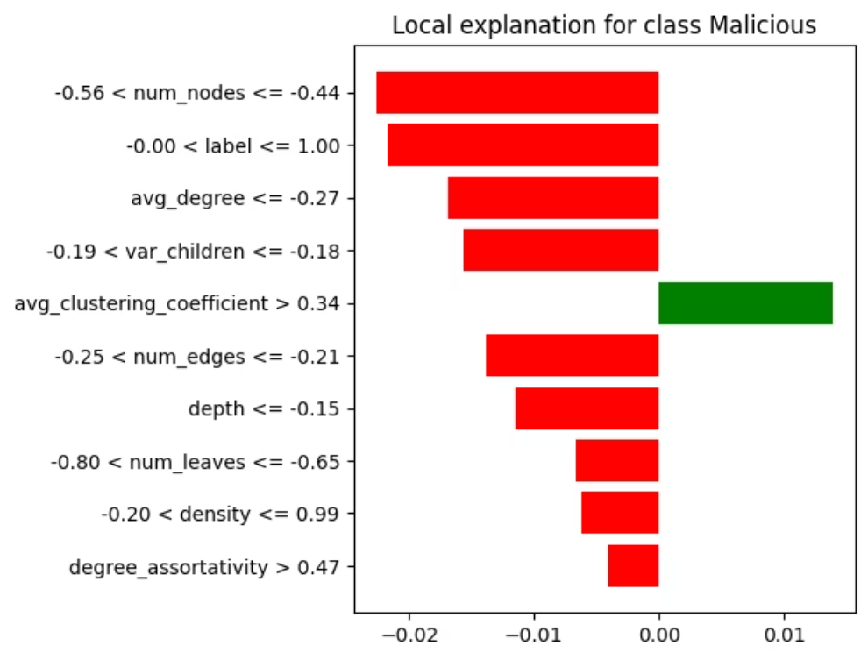
Explaining Model With LIME
LIME shows that our graph-structural features (degree, leaves, node count) dominate the decision, confirming they’re reliable discriminators in our model.
Even though a few features (e.g. depth) individually suggest Malicious, the aggregate influence of structural features overwhelmingly drives the decision to Benign.
Interpretability improves trust and aids model refinement.

Slide 12
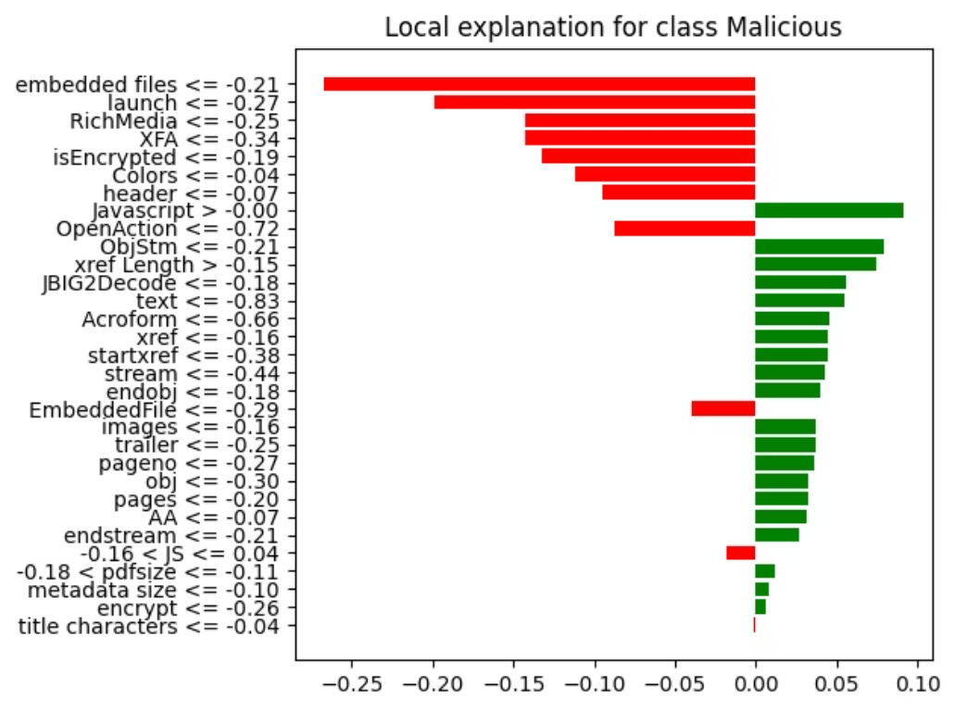
Explaining Model With LIME
Dataset 1: example of how features impact prediction

Slide 13
Thank You

